Slide 1
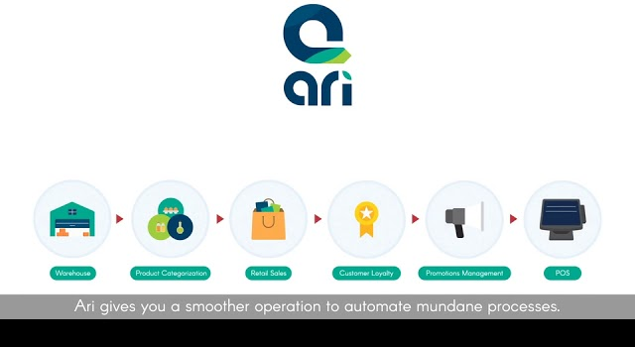

By: Davinder Verma

Slide 2
A Quality Retail POS Software
It is industry leading software by Web Masters’.
The software is made for ease of use.
The UI is designed for unique customer experience

Slide 3
benefits
Attracts more sales
Gain competitiveness
Stay Agile in Business
Clear Insights Everywhere
Inventory Optimization
Integrated POS

Slide 4
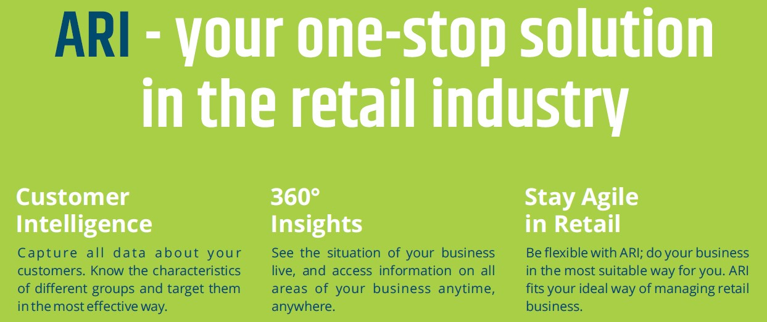

Slide 5
Software includes
POS software
Customer Rewards Program
Promotions Management
Inventory Management
Multi-Store Management
Supply Chain Management

Slide 6
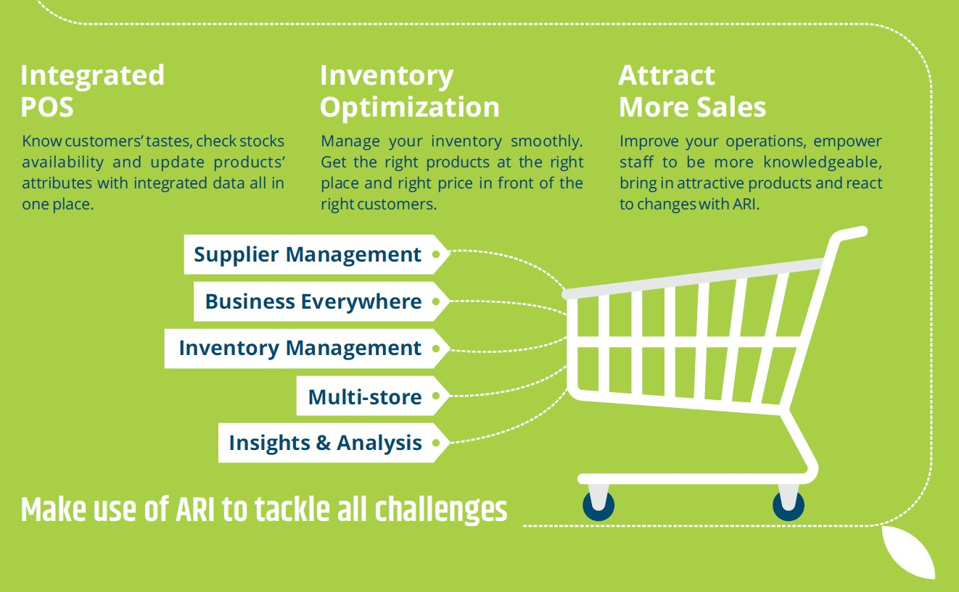

Slide 7
Integrations with
Xero
Microsoft Dynamics 365
QuickBooks
Retail Insight
Tally
MailChimp

Slide 8
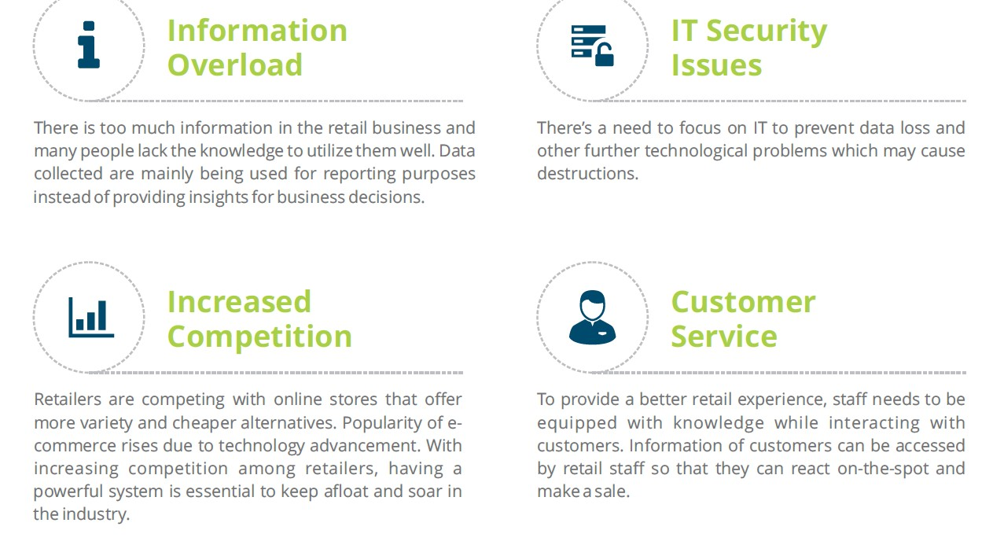

Slide 9
Challenges solved by using ari
Loyalty Problem
01
Demand has Changed
02
Increased Competition
03
Stagnant Customer Service
04
IT Security Issues
05
Information Overload
06

Slide 10
Increase competitiveness using ari
It uses data gathered on customers for providing better retail strategy
Tailored for attracting customers by their preferences
The personal touch for every customer creates amazing experiences

Slide 11
POS System
It is fast and secure
Highly Customizable
Well-connected with back-office
Multi-lingual
Multiple Payment Options
Cash Drawer Restriction

Slide 12
Pros of pos software
Intuitive Interface
Real time sync and offline operations
Vouchers, Gift Cards, and Loyalty Program
Tax & Discounts
User Profiles
Reports

Slide 13
Why choose ari?
Great customer service
Competitive Software Pricing
Saves time and manpower
Highly Customizable
Amazing UI
Multiple Payment

Slide 14
Criteria | No | With some modifications | Yes
Schedule employees to work at multiple locations. Must allow employees to be categorized by job type.
Is the software affordable?
What operating system will this run under? | Web Module:- Any device with web browser POS:- Windows 7 and higher / Apple OS X and above
Hardware requirements or devices required | 4 GB ram, 10 GB storage, 2Ghz Clock speed processor

Slide 15
Thank For Watching
😀

